Slide 1

Notes:
1st slide (Mandatory)

Slide 2
Interview Skills – 1.2

Slide 3
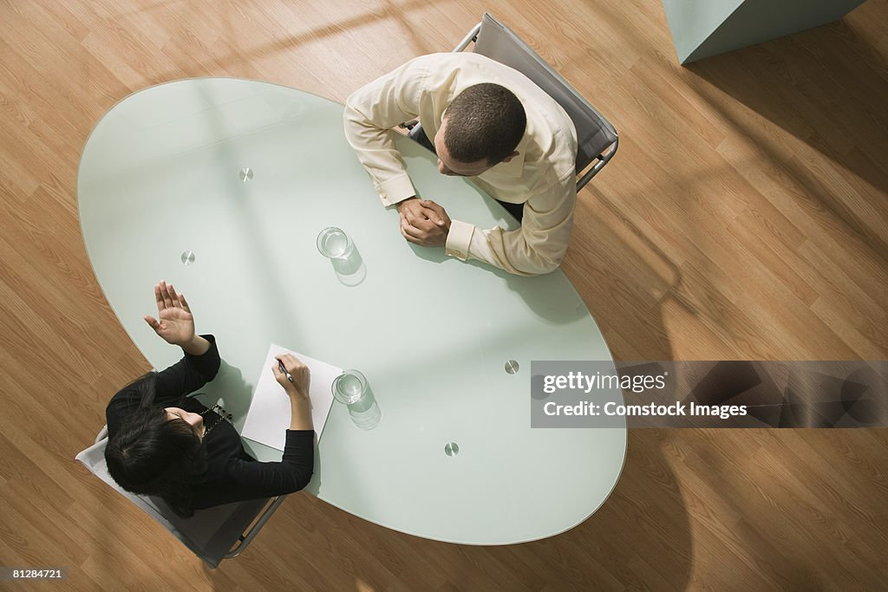

Slide 4
Structured and unstructured interview orientation
Structured and unstructured interviews represent two different approaches to conducting job interviews, each with its own set of characteristics and advantages. Here's an overview of both:
Structured Interview:
Characteristics:
Standardized Questions:
The interviewer asks the same set of predetermined questions to all candidates.
Questions are often directly related to the job requirements.

Slide 5
Consistency:
The goal is to maintain consistency across all interviews to ensure fairness in the evaluation process.
Each candidate is assessed on the same criteria.
Objective Evaluation:
Structured interviews aim for objectivity in evaluation by using a standardized process.
Interviewers score responses based on predefined criteria.
Quantifiable Data:
The structured format allows for easier collection and comparison of quantifiable data.
This method is suitable for numerical ratings or scoring systems.

Slide 6
Reduced Bias:
Structured interviews aim to minimize interviewer bias by sticking to a predetermined script.
This helps create a fair and unbiased evaluation process.
Job-Related Skills Assessment:
Questions are designed to assess specific job-related skills and competencies.
The focus is on understanding how well the candidate aligns with the job requirements.

Slide 7
Unstructured Interview:
Characteristics:
Flexible and Dynamic:
The interviewer has more flexibility and can adapt the conversation based on the candidate's responses.
Questions may arise spontaneously during the interview.
In-Depth Exploration:
Allows for a deeper exploration of the candidate's background, experiences, and personality.
Follow-up questions can delve into specific areas based on the candidate's responses.

Slide 8
Subjective Evaluation:
Evaluation is more subjective, relying on the interviewer's judgment and intuition. There is often less emphasis on standardized scoring.
Establishing Rapport:
Unstructured interviews often focus on building a rapport between the interviewer and the candidate. The conversation may be more conversational.
Holistic Assessment:
Aims to provide a holistic view of the candidate, considering not only job skills but also interpersonal skills, cultural fit, and potential for growth.
Exploration of Soft Skills:
Allows for a more in-depth exploration of soft skills such as communication, problem-solving, and adaptability.
The focus is on understanding the candidate's overall qualities and potential contributions.

Slide 9
Closed questions and hypothetical Questions
Closed Questions:
Closed questions are those that typically require a short and specific answer. These questions often have a finite set of possible responses and are designed to gather specific information.
Answer Format:
Closed questions usually elicit a "yes" or "no" response or a brief piece of specific information.
Limited Response Options:
The range of acceptable answers is restricted, providing little room for elaboration.

Slide 10
Clarity and Precision:
Closed questions are clear and precise, aiming to extract specific details.
Quick Information Gathering:
They are useful for quickly gathering specific facts or confirming details.
Example Closed Questions:
Did you complete the project on time?
Have you worked with XYZ software before?
Is your preferred work location flexible?

Slide 11
Hypothetical Questions:
Hypothetical questions, on the other hand, present a scenario or situation and ask the interviewee to imagine how they would respond. These questions are often used to assess problem-solving skills, creativity, and the ability to think critically. Here are some characteristics of hypothetical questions:
Imagination and Creativity:
Hypothetical questions require the candidate to imagine a situation and think creatively about potential solutions or actions.
Behavioral Predictions:
They are often used to predict future behavior based on how a candidate might handle a hypothetical scenario.

Slide 12
Problem-Solving Assessment:
These questions assess a candidate's ability to analyze situations and come up with effective solutions.
Assessing Adaptability:
Hypothetical questions can reveal how well a candidate adapts to new or challenging situations.
Example Hypothetical Questions:
How would you handle a situation where you disagreed with your team on a critical decision?
If you were the manager, how would you motivate a team facing a tight deadline and low morale?
Suppose you encounter a technical problem during a presentation. How would you handle it?

Slide 13
Interviewers’ perspective, Questions to ask/not ask during an interview
From an interviewer's perspective, selecting the right questions is crucial to gather relevant information, assess a candidate's qualifications, and determine their fit for the position and company culture. Here are guidelines on questions to ask and avoid during an interview:
Questions to Ask:
Job-Related Skills and Experience:
Ask about specific skills and experiences relevant to the job.
Example: "Can you provide an example of a project where you demonstrated strong problem-solving skills?"

Slide 14
Behavioral Questions:
Pose questions that require candidates to share past behaviors, revealing their approach to challenges.
Example: "Tell me about a time when you had to meet a tight deadline. How did you handle it?"
Cultural Fit:
Inquire about the candidate's values, work style, and preferences to assess cultural fit.
Example: "What type of work environment do you thrive in?"
Motivation and Passion:
Understand the candidate's motivation for the role and their passion for the industry.
Example: "What attracted you to our company, and why do you want to work here?"
Communication Skills:
Assess verbal and written communication skills through relevant questions.
Example: "Can you walk me through your thought process when communicating complex ideas to a non-technical audience?"

Slide 15
Problem-Solving and Decision-Making:
Present scenarios or ask about past experiences to evaluate problem-solving abilities.
Example: "How do you approach making decisions in high-pressure situations?"
Professional Development:
Explore the candidate's commitment to continuous learning and professional development.
Example: "How do you stay updated on industry trends, and what skills are you currently working to improve?"
Teamwork and Collaboration:
Understand how well the candidate works in a team and collaborates with colleagues.
Example: "Can you share an example of a successful collaboration with a team on a project?"

Slide 16
Questions to Avoid:
Illegal or Discriminatory Questions:
Avoid questions related to age, gender, marital status, religion, or any other protected characteristics.
Example: "Do you have children? Are you planning to start a family?"
Leading Questions:
Questions that guide the candidate toward a specific answer can be misleading.
Example: "You're comfortable with leading a team, right?"
Overly Personal Questions:
Stay focused on professional aspects; avoid intrusive personal questions.
Example: "Tell me about your personal life and hobbies."

Slide 17
Negative Framing:
Avoid framing questions in a negative manner, which may make candidates uncomfortable.
Instead of asking, "What are your weaknesses?" consider asking, "How do you approach areas where you see opportunities for improvement?"
Unrelated or Irrelevant Questions:
Ensure that all questions directly relate to the candidate's ability to perform the job.
Example: "What is your favorite color?" (unless relevant to the job).
Hypothetical Legal Situations:
Avoid presenting hypothetical situations that may lead to discriminatory or unfair assessments.
Example: "If you were pregnant, how would you handle the demands of this job?"
Invasive Health Questions:
Health-related questions should be avoided unless directly related to the job's requirements.
Example: "Do you have any medical conditions or disabilities?"

Slide 18
Video interview, Recorded feedback, Phone interview preparation
Video Interview Preparation:
Technical Setup:
Test your camera, microphone, and internet connection in advance.
Ensure you have the necessary software or platform installed (e.g., Zoom, Microsoft Teams).
Background and Lighting:
Choose a clean, clutter-free background.
Ensure you have sufficient, well-distributed lighting to be clearly visible.

Slide 19
Dress Professionally:
Dress as you would for an in-person interview to convey professionalism.
Eye Contact:
Look directly into the camera to simulate eye contact and appear engaged.
Minimize Distractions:
Inform household members about the interview time.
Turn off notifications on your computer or phone.

Slide 20
Practice Video Etiquette:
Wait for the interviewer to finish speaking before responding.
Avoid interrupting, and be mindful of your body language on camera.
Prepare a Quiet Space:
Choose a quiet room to conduct the interview, minimizing background noise.
Have Materials Ready:
Keep your resume, notes, and any other relevant materials nearby for reference.

Slide 21
Recorded Feedback (Self-Recorded Video):
Review Job Description:
Understand the key requirements of the job to tailor your responses effectively.
Practice Common Questions:
Practice answering common interview questions.
Use the STAR method (Situation, Task, Action, Result) for behavioral questions.
Evaluate Body Language:
Record yourself answering questions to assess your body language and facial expressions.

Slide 22
Time Management:
Ensure your responses are concise and within a reasonable time frame.
Background Check:
Review your background to ensure it appears neat and professional.
Audio Check:
Assess the clarity of your voice and adjust your microphone if needed.
Dress Rehearsal:
Dress professionally as you would for a live interview.

Slide 23
Phone Interview Preparation:
Choose a Quiet Location:
Find a quiet space with minimal background noise for the call.
Test Your Phone:
Check your phone's signal strength and ensure it's fully charged.
Prepare Materials:
Have a copy of your resume, the job description, and any notes handy.
Practice Speaking Clearly:
Enunciate your words clearly and speak at a moderate pace.

Slide 24
Avoid Multitasking:
Focus solely on the interview; avoid distractions or multitasking.
Have a Glass of Water:
Keep a glass of water nearby in case you need it during the call.
Ask About the Format:
Inquire about the interview format and whether there will be any specific assessments.
Listen Actively:
Pay close attention to the interviewer's questions and respond thoughtfully.
Remember to adapt your preparation based on the specific requirements and nuances of each interview format. Practice, review, and refine your approach to boost your confidence and increase your chances of success.

Slide 25
Tips to customize preparation for personal interview, Practice rounds
Customizing your preparation for a personal interview involves tailoring your approach to the specific role, company, and industry you're targeting. Here are tips to help you personalize your interview preparation and conduct effective practice rounds:
Customizing Preparation:
Research the Company:
Understand the company's values, mission, and culture.
Research recent news or developments to show that you're informed.
Job Description Analysis:
Break down the job description to identify key skills and qualifications.
Customize your responses to align with the specific requirements.

Slide 26
Know Your Resume:
Be ready to discuss your resume thoroughly.
Highlight experiences and skills relevant to the position.
Understand Industry Trends:
Stay updated on industry trends and news.
Discuss how your skills align with current industry needs.
Tailor Your Achievements:
Customize your achievements to showcase their relevance to the role.
Quantify your impact wherever possible.
Prepare for Behavioral Questions:
Anticipate questions about your past experiences.
Use the STAR method to structure your responses.

Slide 27
Address Weaknesses Proactively:
Identify potential weaknesses and prepare to address them positively.
Emphasize your commitment to continuous improvement.
Know Your Strengths:
Clearly articulate your strengths and how they contribute to the role.
Provide examples of how you've utilized your strengths in previous positions.
Prepare Questions:
Develop thoughtful questions to ask the interviewer.
Tailor them to demonstrate your genuine interest in the company.

Slide 28
Practice Rounds:
Mock Interviews:
Conduct mock interviews with a friend or family member.
Choose someone who can provide constructive feedback.
Vary Interview Formats:
Practice in different interview formats (e.g., behavioral, technical, situational).
This prepares you for various aspects of the interview process.
Record Yourself:
Use video recording to analyze your body language, tone, and presentation.
Identify areas for improvement.
Receive Feedback:
Seek honest feedback from your mock interviewer.
Focus on areas that need improvement and work on refining your responses.
Time Yourself:
Practice answering questions within a realistic time frame.
Ensure your responses are concise and to the point.

Slide 29
Adaptability Practice:
Practice adapting to unexpected or challenging questions.
This prepares you for curveballs that might come your way.
Build Confidence:
The more you practice, the more confident you'll become.
Confidence positively impacts your performance during the actual interview.
Repeat the Process:
Conduct multiple practice rounds to refine your responses and build consistency.
Make adjustments based on feedback from each session.
Visualize Success:
Visualize a successful interview scenario.
This mental preparation can positively impact your actual performance.
Remember that interview preparation is an ongoing process. Continuously refine your responses, seek feedback, and adapt your approach based on your experiences in practice rounds. This personalized and iterative preparation will enhance your confidence and readiness for the actual interview.

Slide 30
https://docs.google.com/forms/d/e/1FAIpQLSeWrjjBJQZIxBEIEZaSqLqUnAfWkZ43XWgO2WvII_6g5199iA/viewform?usp=preview

Slide 31
THANK YOU

